Slide 1
National Council of Educational Research and Training, New Delhi.
And
State Council of Educational Research and Training, Maharashtra.
Mendeley- Open Referencing Tool
Dated 13th to 17th February, 2023, Nagpur

Slide 2
Presentation by Yogesh R. Sonawane
(M.A.,B.Ed. M.Ed.NET, M.Phil.)
HoD, IT dept.,
SCERT Maharashtra, Pune
Global Teacher Educator
ysonawane@maa.ac.in
Yo_gi1830
Yogesh.sonawane.9003
Global Teacher Educator
9145825144
Always Learn more

Slide 3
Mendeley…
literature management tool

Slide 4
Referencing all your reading in your work demonstrates that you have conducted a thorough and appropriate literature search.
What is referencing?
Source of information or studies
Citations are very important in any article
Scientific presentation/proofing

Slide 5
A "citation" is the way you tell your readers that certain material in your work came from another source. It also gives your readers the information necessary to find that source again, including
information about the author
the title of the work
the name and location of the company that published your copy of the source
the date your copy was published
the page numbers of the material you are borrowing
What is citation?
Caulfield, J. (2022, June 27).
https://www.scribbr.com/citing-sources/citation-example/

Slide 6
What is citation?
What is referencing?
What is Bibliography?
1. Single specific source
2. In quote form
3. In content body
4. Small part
1. Cluster/list of source
2. In sentence form
3. At the end of last chapter
4. Large part
1. Cluster/list of source
2. In sentence form
3. At the end of chapter/paper
4. Large part
(Ashbourn, 2014)
Derwing, T. M., Rossiter, M. J., & Munro, M. J. (2002). Teaching native speakers to listen to foreign-accented speech. Journal of Multilingual and Multicultural Development, 23(4), 245-259.
Mintel (2019) Sports and energy drinks - UK. Available at: http://www.academic.mintel.com (Accessed: 5th July 2022).

Slide 7
styles
APA- American Psychological Association (7th edi.)
CMS- Chicago Manual Style (17th edi.)
IEEE- The Institute of Electrical and Electronics Engineers
MLA- Modern Language Association (8th edi.)
Harward Reference Format
Nature
Vancouver

Slide 8
Discipline wise Styles
Discipline | Typical citation style(s)
Economics | Harvard
Engineering & IT | IEEE
Humanities | Chicago notes and bibliography; Harvard; MLA
Law | Bluebook; OSCOLA
Medicine | AMA; NLM; Vancouver
Political science | APSA
Psychology | APA
Sciences | ACS; Chicago author-date; CSE citation-name or citation-sequence; CSE name-year; Harvard
Social sciences Education | AAA; APA; ASA; Chicago author-date APA
(source- https://www.scribbr.com/citing-sources/citation-styles/)

Slide 9
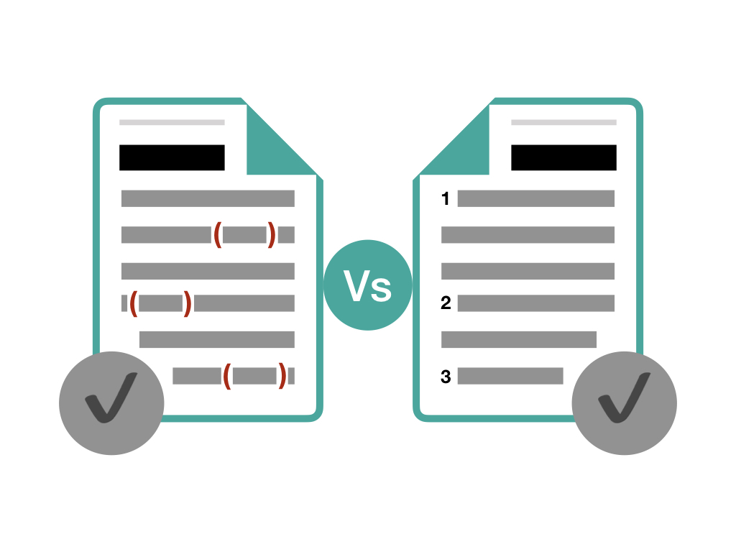
What is your current process of citation and references?
Current process-
Writing all citations manually
Alphabetic arrangement
Rewrite final references
Editing as per style
(source- https://thephdhub.com/key-differences-between-citation-vs-references/)

Slide 10
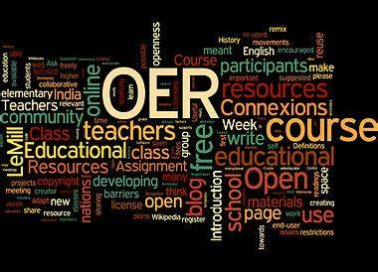
OER tools useful for data presentation?

Slide 11
Reference manager tools
Free-
Mendeley
Endnote
Paid-
refmanager,
Bibtex,
Zotero,
Refwork,
Wisdom.ai,
Papers

Slide 12
Mendeley…reference management tool
Mendeley is a free reference manager
Can help you collect references, organize your citations, and create bibliographies.
Mendeley is also an academic social network that enables you to share your research with others. Researchers can collaborate online in public or private groups, and search for papers.
Mendeley can help you connect with other scholars and the latest research in your subject area.
Mendeley is owned by Elsevier, the leading provider of science and health information,

Slide 13
(source- https://www.youtube.com/watch?v=nmcj-GhicDk)

Slide 14
How to use Mendeley?

Slide 15
Importance of Mendeley in research
Collect references from the Web and UCI databases
Automatically generate citations and bibliographies
From within your citation library, read, annotate and highlight PDFs
Collaborate with other researchers online
Import papers from other research software
Find relevant papers based on what you’re reading
Access your papers from anywhere online
Read papers on the go with your iPhone or iPad
Build a professional presence with your Mendeley profile

Slide 16
Thank! Over To You!

